Slide 1
CSE 445 Project Heart Disease Prediction Using Machine Learning
By
Tanjil Mahmud 1821458042
Md Abir Hossain 1731597
Emamul Hassan 1731250

Slide 2
Heart Disease Dataset
Heart disease is also known as Cardiovascular diseases (CVDs) are the number 1 cause of death globally, taking an estimated 17.9 million lives each year which is about 32% of all deaths globally.
We have curated this dataset by combining different datasets already available independently but not combined before. We have combined them over 11 common features which makes it the largest heart disease dataset available for research purposes.
The five datasets used for its curation are:
Cleveland: 303
Hungarian: 294
Switzerland: 123
Long Beach VA: 200
Stalog (Heart) Data Set: 270
Total 1190
Link: kaggle.com

Slide 3
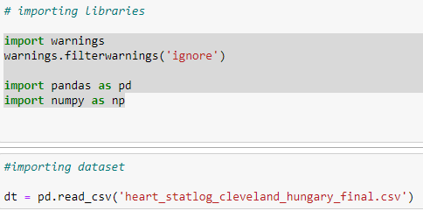
Heart Disease Prediction Steps:
Step 1: Importing necessary library and Chosen Dataset.

Slide 4
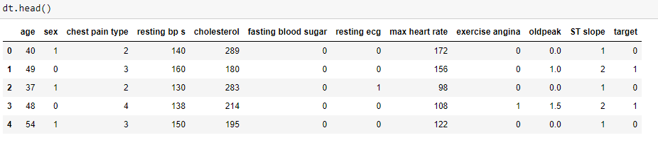
Heart Disease Prediction Steps:
Step 2: Checking column using dt.head() to check column names.

Slide 5
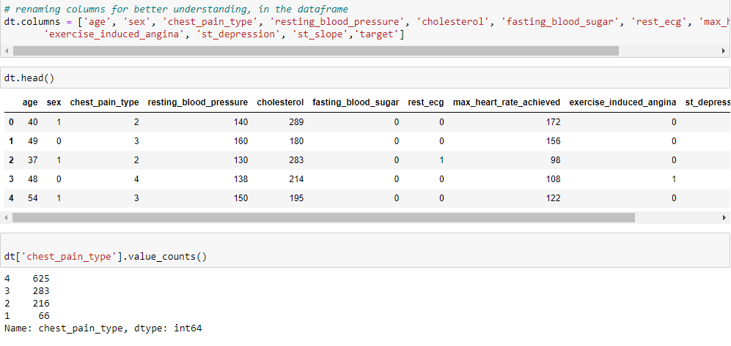
Heart Disease Prediction Steps:
Step 3: Renaming column for better understanding.

Slide 6
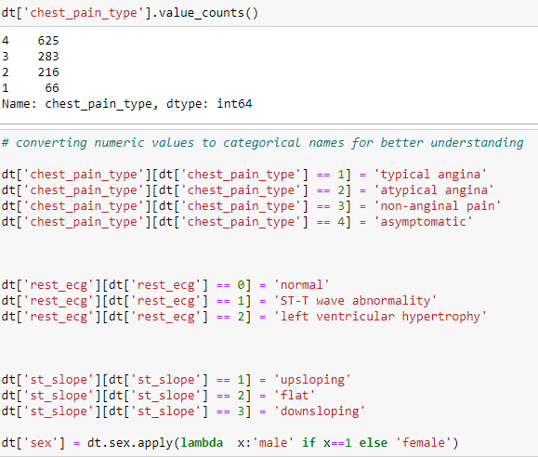
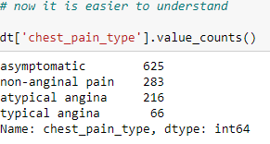
Heart Disease Prediction Steps:
Step 4: Printing chest_pain_types and converting numerical values to categorical names for better understanding and printing it again to check.

Slide 7
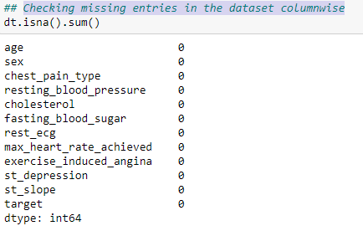
Heart Disease Prediction Steps:
Step 5: Checking missing entries in the dataset to see if there is any empty value in every column.

Slide 8
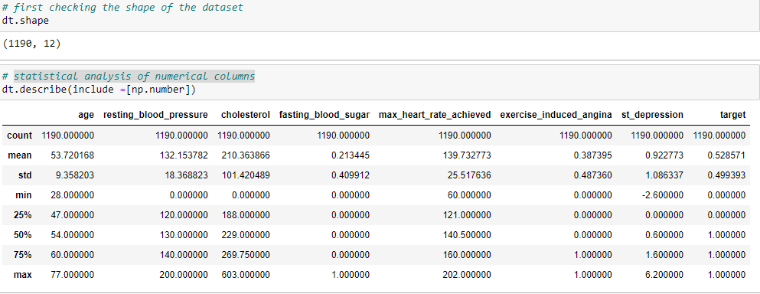
Heart Disease Prediction Steps:
Step 6: Checking the Shape(row and column number) and then printing the statistical analysis of numerical columns.

Slide 9
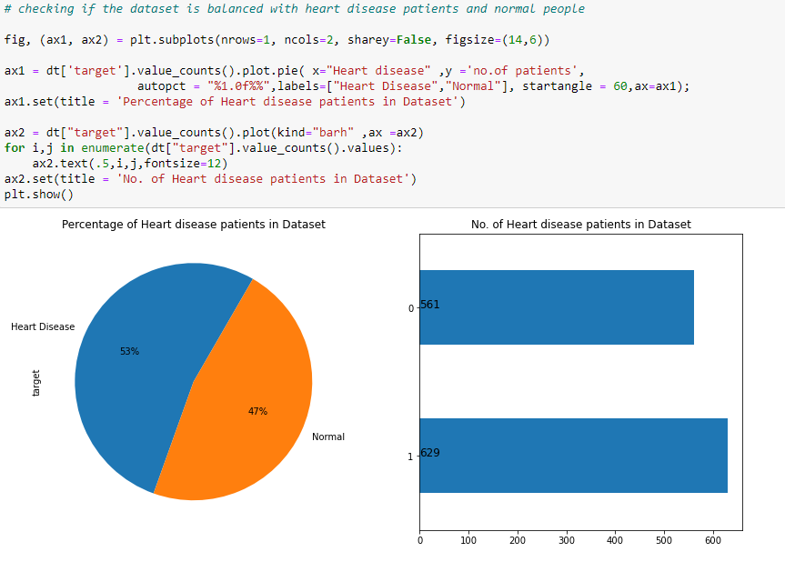
Heart Disease Prediction Steps:
Step 7: Checking if the dataset is balanced, as it might create a problem if its not balanced. Our dataset is balanced with 53% and 47%.

Slide 10
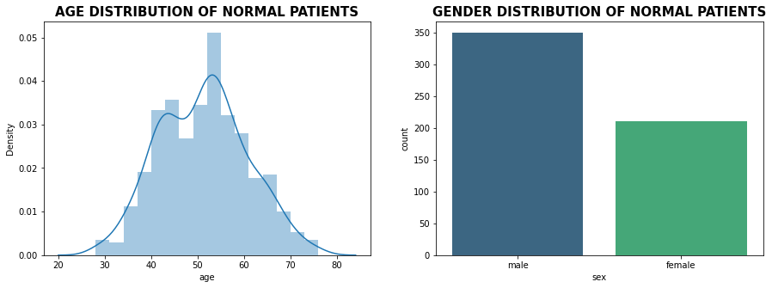
Heart Disease Prediction Steps:
Step 8: Plotting normal patients age and sex

Slide 11
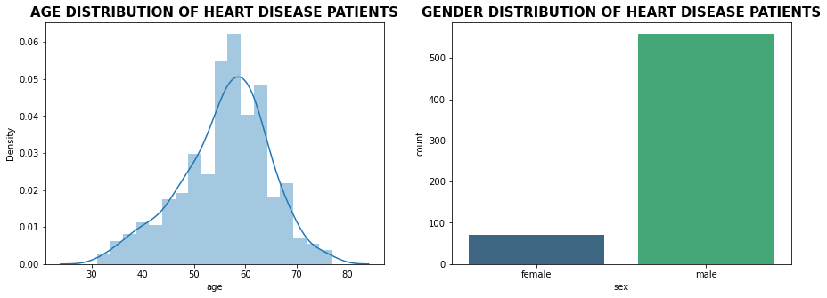
Heart Disease Prediction Steps:
Step 9: Plotting heart patients age and sex.

Slide 12
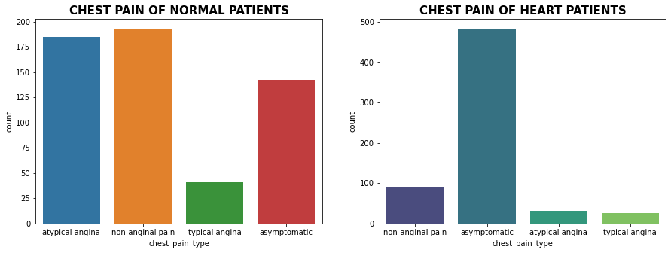
Heart Disease Prediction Steps:
Step 10: Checking Chest Pain differences between heart patient and normal person.

Slide 13
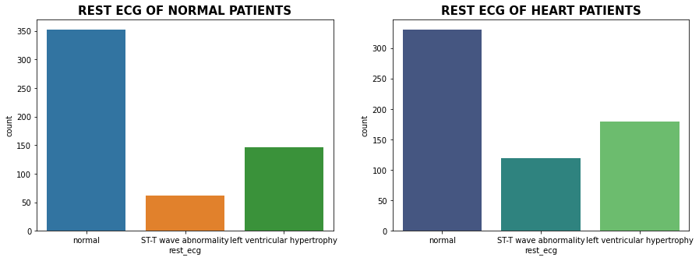
Heart Disease Prediction Steps:
Step 11: Checking Resting ECG differences between heart patient and normal person.

Slide 14
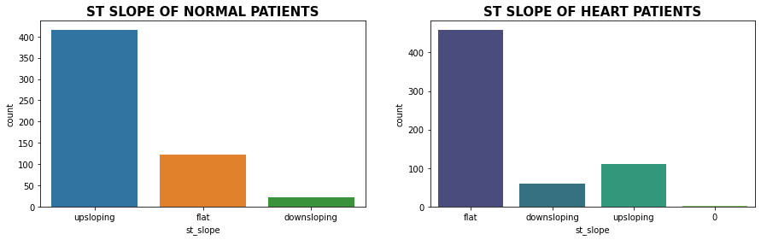
Heart Disease Prediction Steps:
Step 12: Checking ST Slope differences between heart patient and normal person.

Slide 15
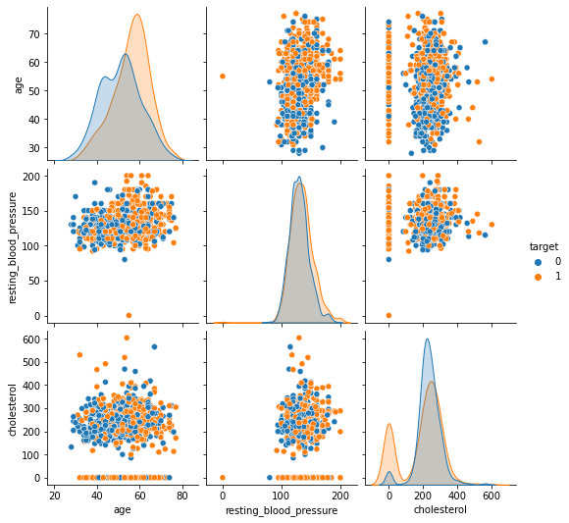
Heart Disease Prediction Steps:
Step 13: For numerical data, we will be using scatterplot to display values for two variables of the data.

Slide 16
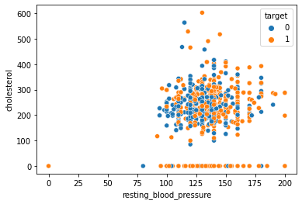
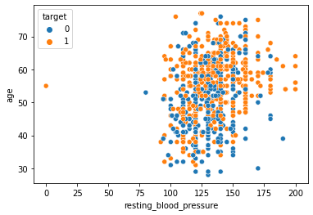
Heart Disease Prediction Steps:
Step 14: After scatterploting, we are seeing outliers for cholesterol vs resting_blood_pressure and age vs resting_blood_pressure, which shows there is 0 as values for blood pressure in both cases.

Slide 17
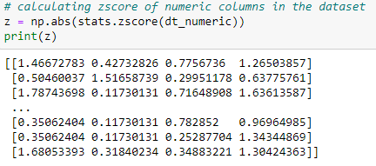
Heart Disease Prediction Steps:
Step 15: As blood pressure = 0 is not possible in real life, we will be filtering those data using z-score.

Slide 18
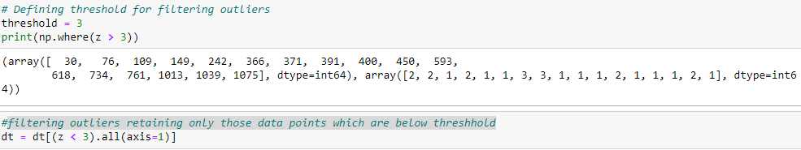
Heart Disease Prediction Steps:
Step 16: Defining threshold(z>3) for filtering outliers and filtering outliers retaining only those data points which are below threshold (z<3).

Slide 19
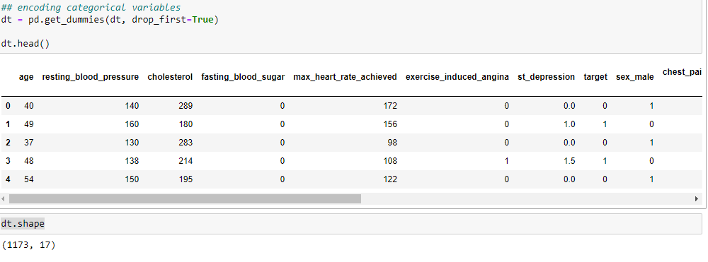
Heart Disease Prediction Steps:
Step 17: One hot encoding categorical values to remove the influence of the categorical values and checking shape again to see the difference.

Slide 20
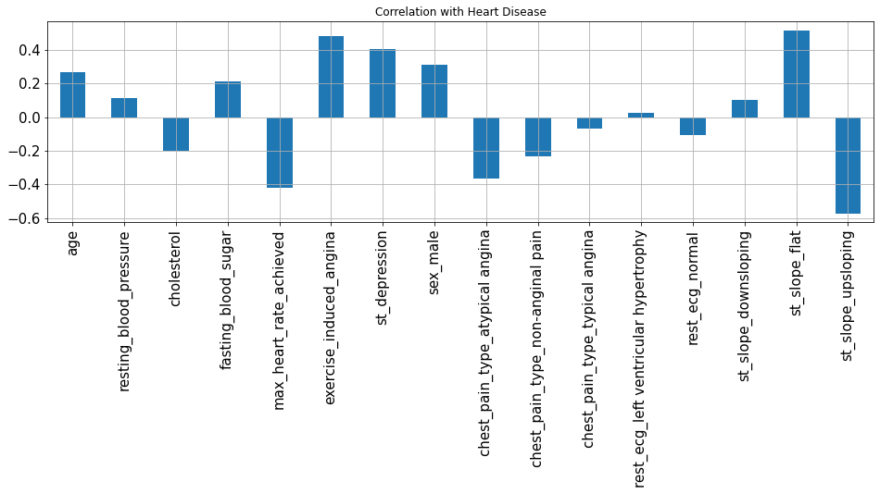
Heart Disease Prediction Steps:
Step 18: Correlation with Response Variable class

Slide 21
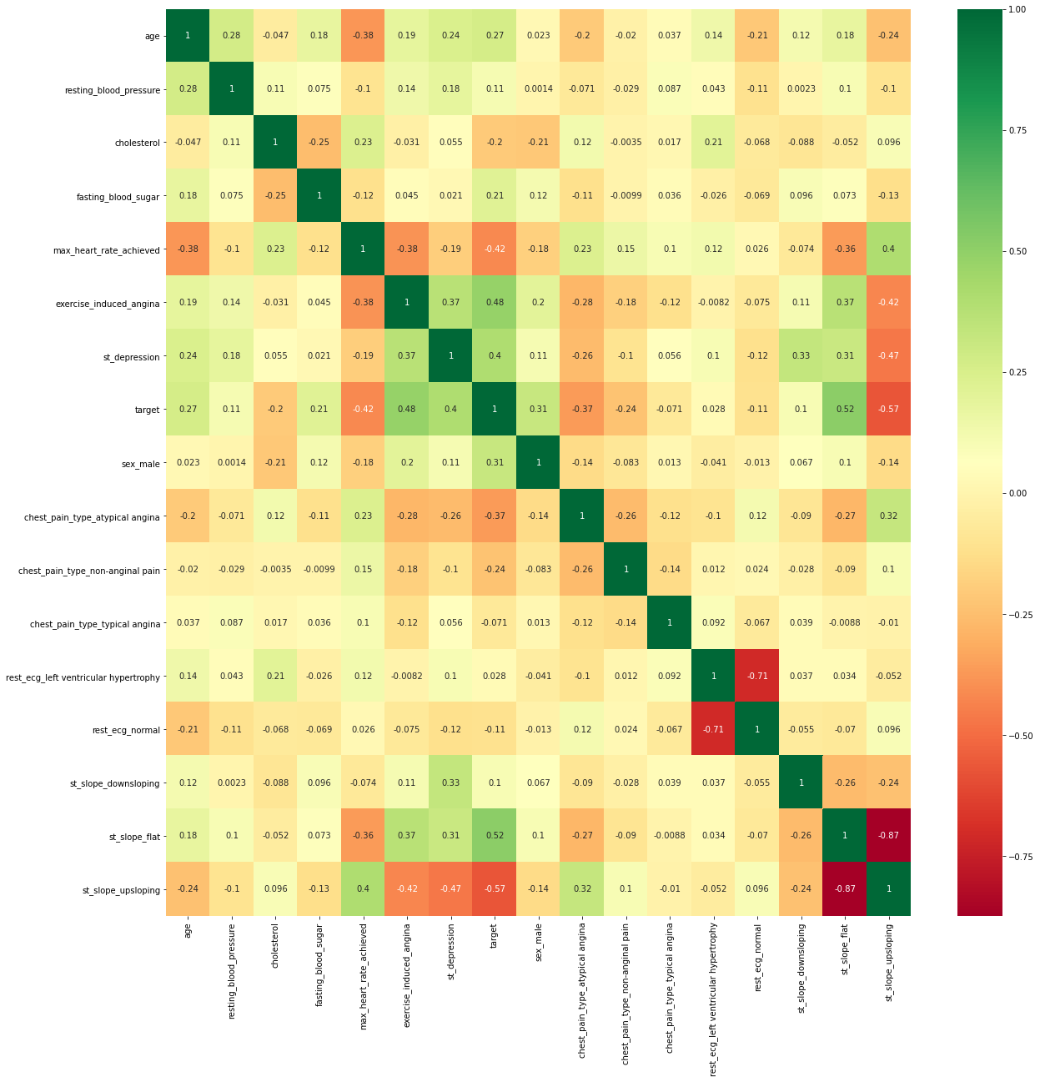
Heart Disease Prediction Steps:
Step 19: Correlation Matrix

Slide 22
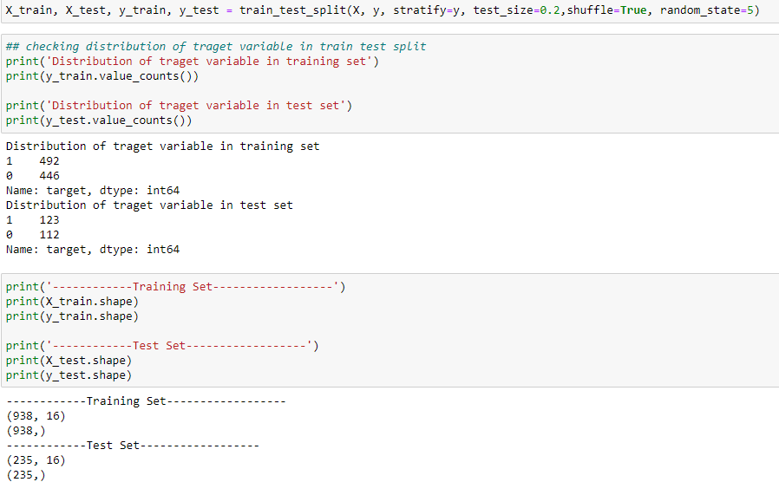
Heart Disease Prediction Steps:
Step 20: Data Splitting

Slide 23
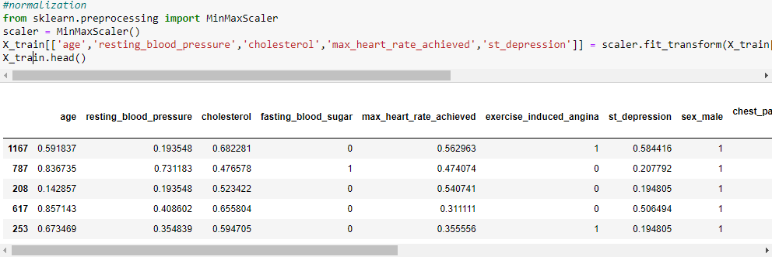
Heart Disease Prediction Steps:
Step 21: Normalization of Training dataset

Slide 24
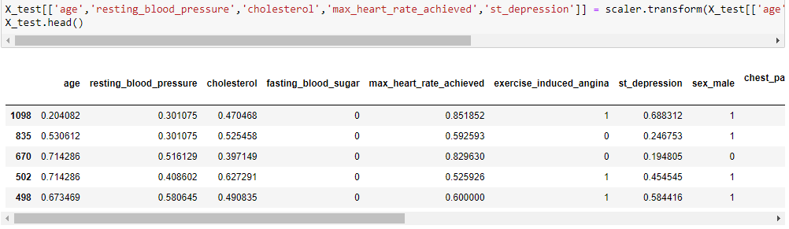
Heart Disease Prediction Steps:
Step 22: Normalization of Testing dataset

Slide 25
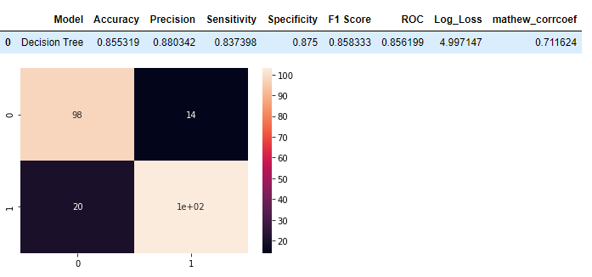
Heart Disease Prediction Steps:
Step 23: Model Building- Decision Tree- a flowchart-like structure in which each internal node represents a "test" on an attribute

Slide 26
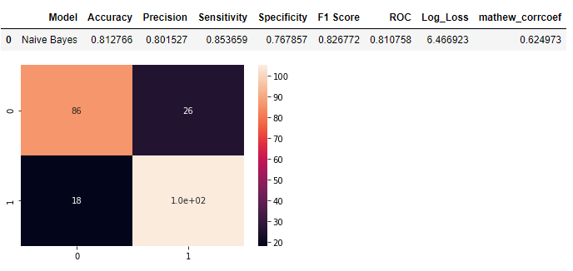
Heart Disease Prediction Steps:
Step 24: Model Building- Naïve Bayes- In statistics, naive Bayes classifiers are a family of simple "probabilistic classifiers" based on applying Bayes' theorem with strong independence assumptions between the features.

Slide 27
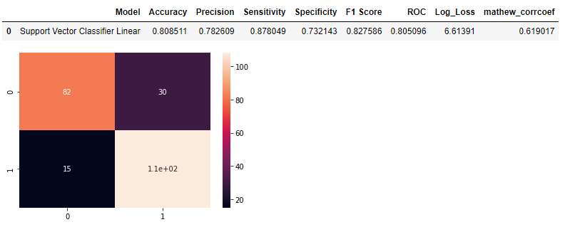
Heart Disease Prediction Steps:
Step 25: Model Building- Support Vector Classifier Linear

Slide 28
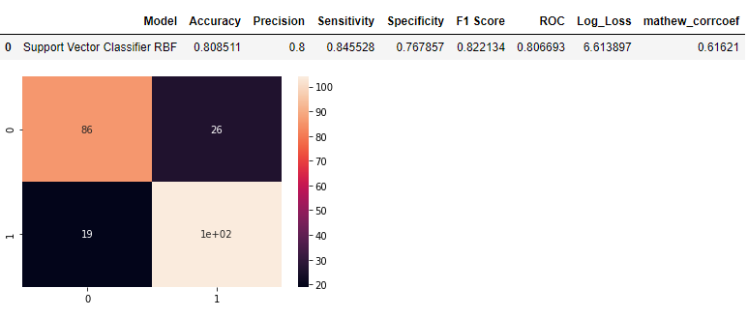
Heart Disease Prediction Steps:
Step 26: Model Building- Support Vector Classifier RBF

Slide 29
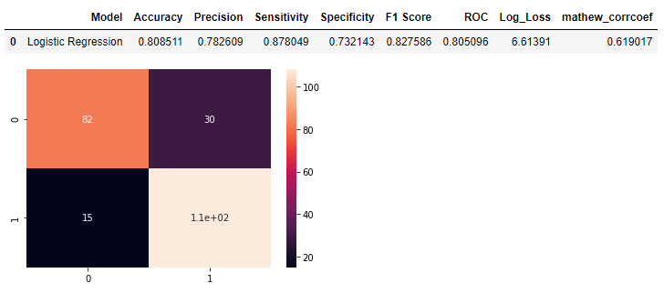
Heart Disease Prediction Steps:
Step 27: Model Building- Logistic Regression

Slide 30
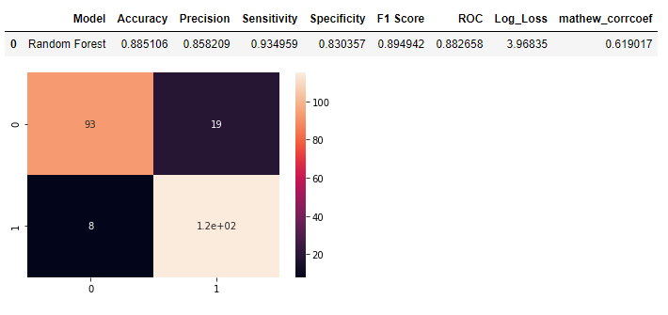
Heart Disease Prediction Steps:
Step 28: Model Building- Random Forest

Slide 31
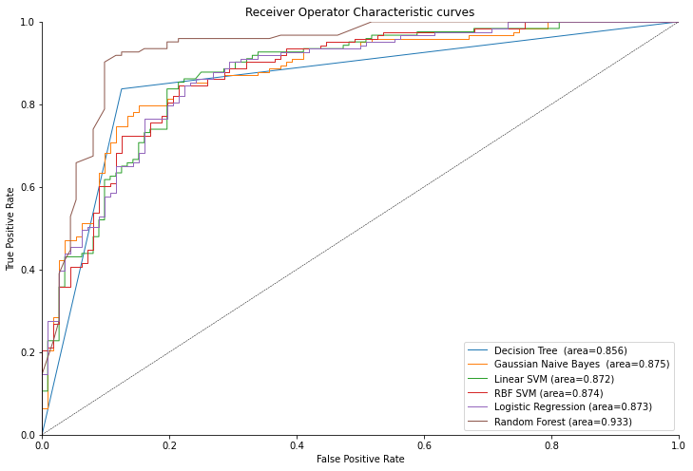
Heart Disease Prediction Steps:
Step 29: ROC- receiver operating characteristic curve

Slide 32
Heart Disease Prediction Steps:
Improvement:
Male-Female ratio in the dataset was imbalanced, it could be balanced using oversampling or undersampling.
High performance model could have been used.
Deployment could have been done.

Slide 33
The End
Thank you everyone.

